Slide 1
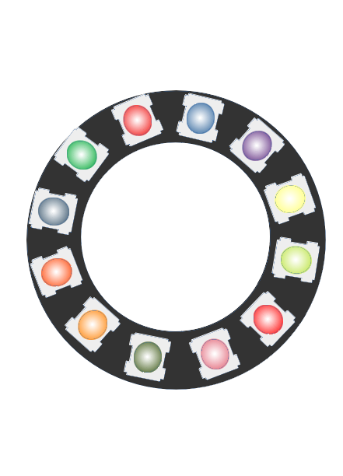
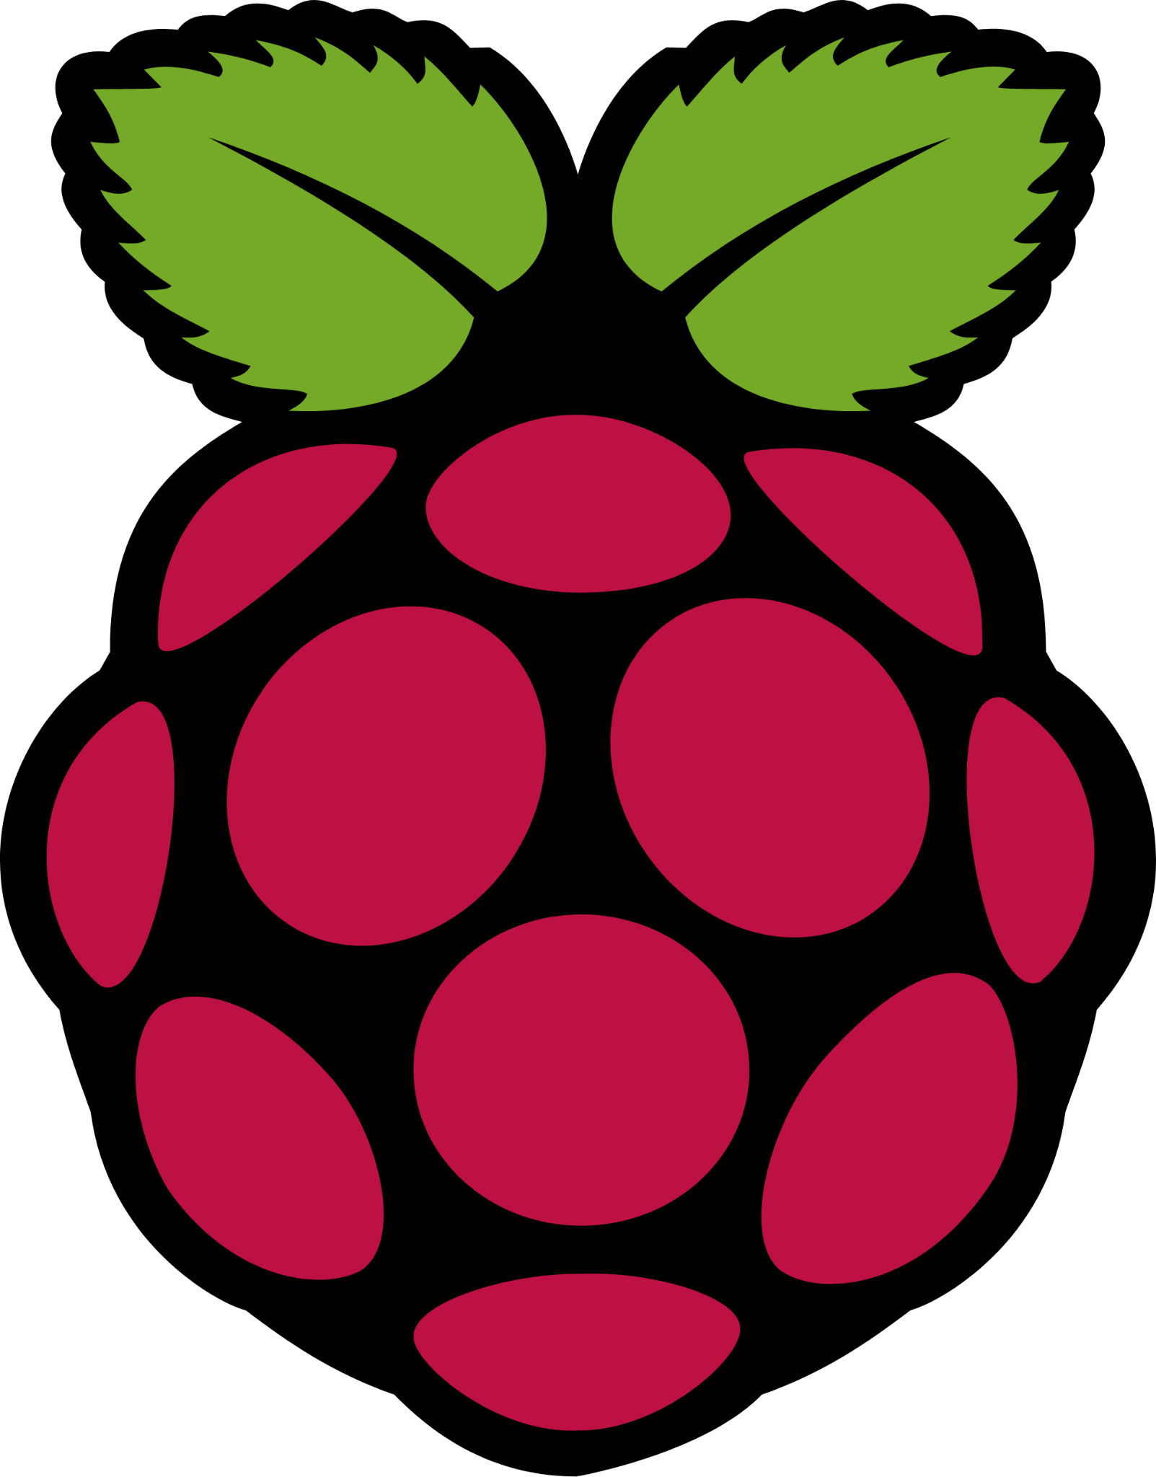
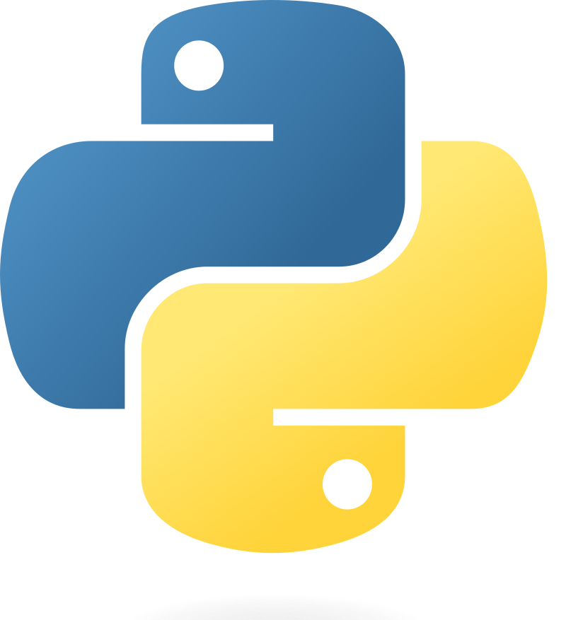

Raspberry Pi and NeoPixel
Get Up And

Slide 2
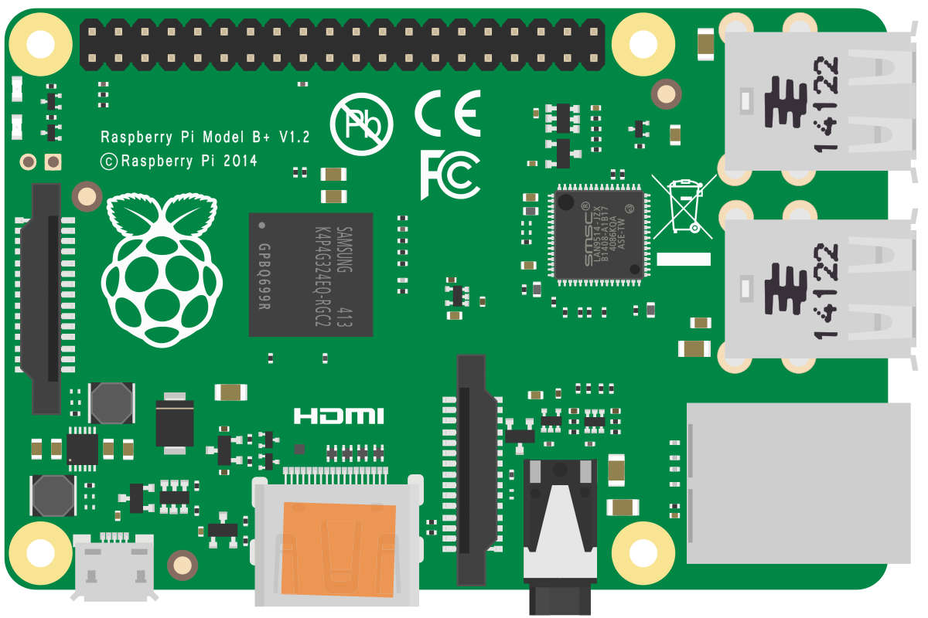
The Raspberry Pi
A credit-card sized mini-computer that serves as the controller for our NeoPixels. We can plug a monitor, mouse, and keyboard into this device and use it to actually write and debug the code.

Slide 3
The NeoPixel
Bright, beautiful, addressable LED arrays. They can be arranged into almost any shapes, not just the circle shown here. Each LED can be set to any color, any brightness you like, and changed whenever you like.

Slide 4
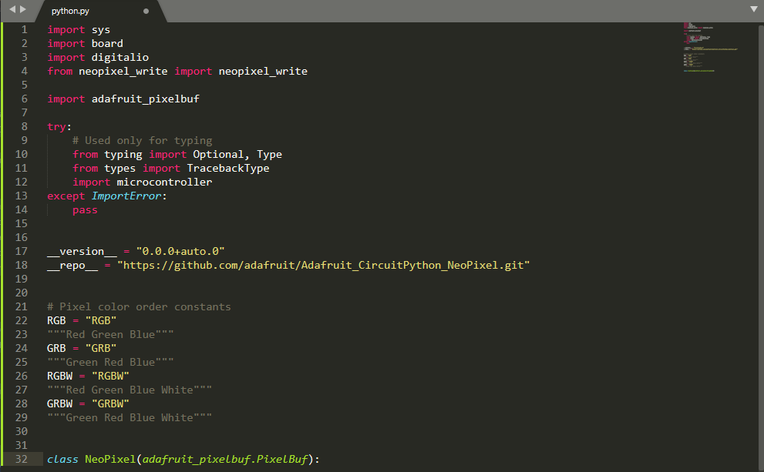
Coded in Python
We’ll write our code in Python3, a wildly popular coding language that’s well suited for first time programmers and veteran coders alike.

Slide 5
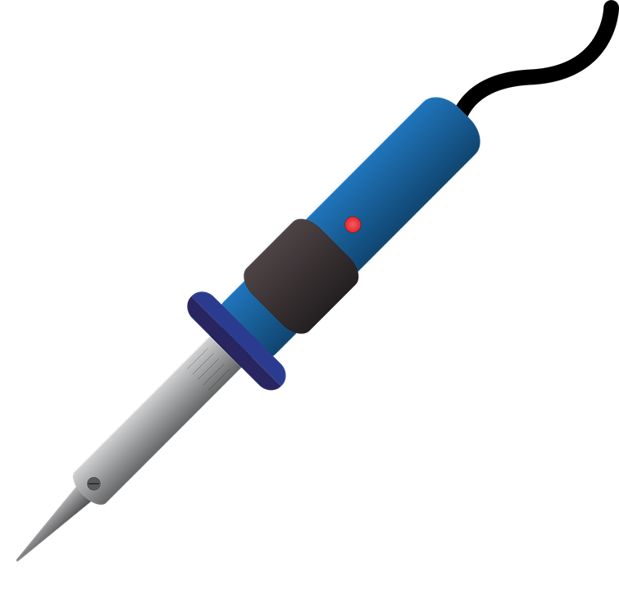
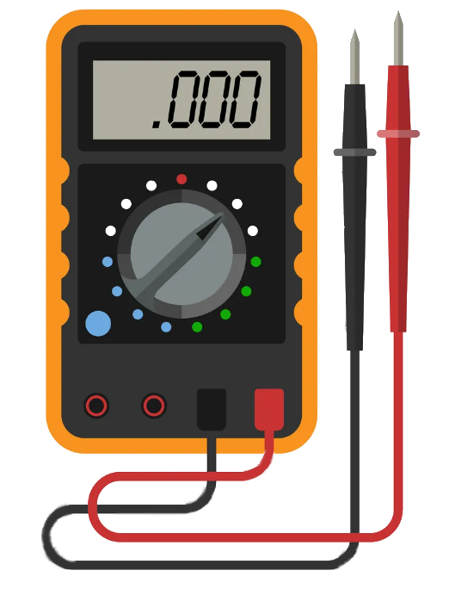
Hands On Circuiteering
Make real things, from real materials, that actually work.

